Slide 1
Palindrome Program in C
Presented By : Zahid Raja
Guide : Ms. Naina Devi (IBM SME)

Slide 2
Problem Statement
Write a program in C to check whether a number is a palindrome or not.
A number is a palindrome if it remains the same when reversed.

Slide 3
Tools Required
Programming Language : C Programming
IDE : Visual Studio Code (VS Code)
Compiler : MinGW (Minimalist GNU for Windows)

Slide 4
Algorithm
Step 1: Read the number
Step 2: Store the original number
Step 3: Reverse the number using loop
Step 4: Compare reversed number with original
Step 5: If equal → Palindrome, else → Not Palindrome

Slide 5
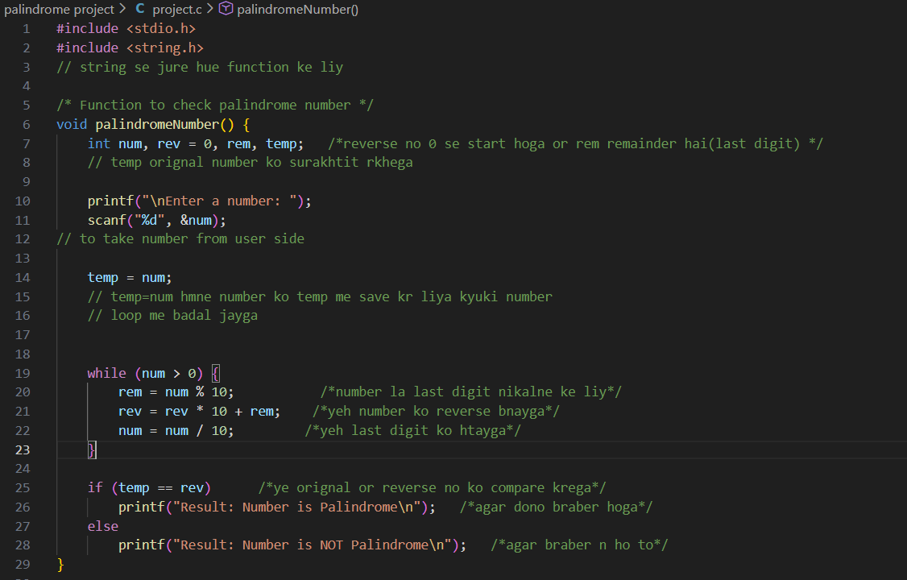
C Program Code

Slide 6
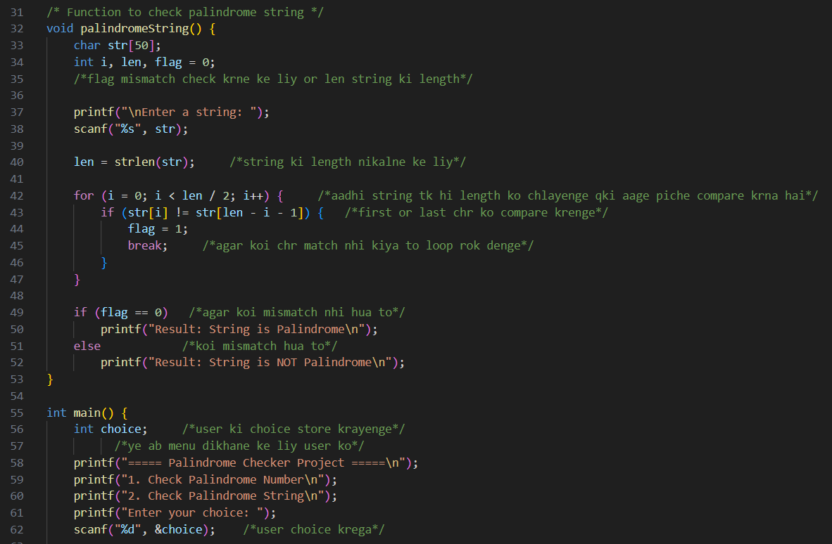

Slide 7
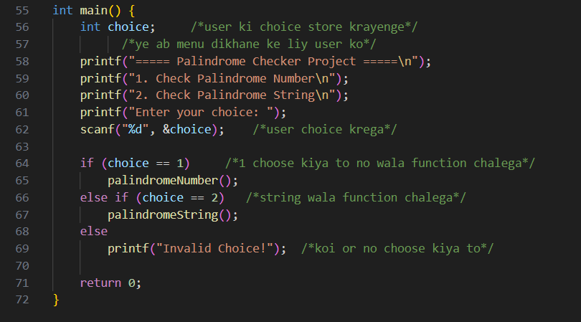

Slide 8
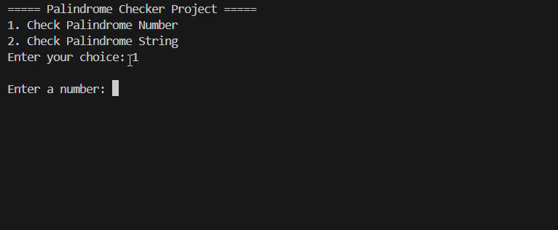
C Program Output

Slide 9
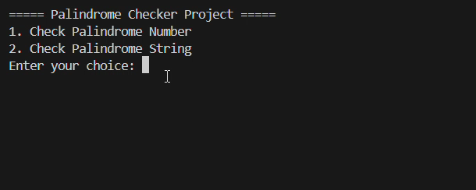
C Program Output

Slide 10
Working Example
Input: 22
Reverse: 22
Result: Palindrome Number

Slide 11
Sample Output
Enter a number: 22
Palindrome number

Slide 12
Conclusion
Palindrome number remains same on reversing
Git Hub Link: https://github.com/zahid-raja/c-programming/tree/main/palindrome%20project
Concept used: Loop + Modulus + Integer Reverse

